Slide 1

How to Save the CAST Template to your Computer
January 2015
This document is proprietary in nature and is provided for the exclusive use of CAST personnel.
The contents are not to be shared with outside parties unless prior written consent is obtained from CAST Management Consultants, Inc.

Slide 2
You have two options for installing the CAST template. The instructions for these options appear on the following pages…
Options for Installing the CAST Template
1
Save the template as the default or “Blank” template. The CAST template will automatically appear each time you open PowerPoint or open a new file. This is the recommended approach.
or
Save the template as an additional template. Your current default template settings will not change. You will need to navigate to the CAST template when you want to use it.
2

Slide 3
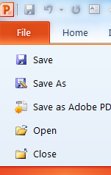
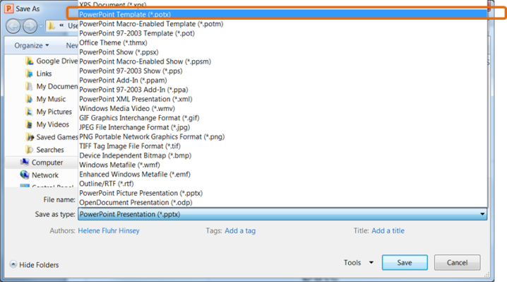
OPTION 1: Save the CAST Template as the Default or “Blank” Template
OPTION
1
STEP | ACTION
1 | Open the CAST Template file attached to the email (CAST Presentation Template_FINAL_01-02-15.potx)
2 | Click the ‘File’ tab on the ribbon and select “Save As.” The “Save As” dialogue box appears.
3 | Click the down arrow in the ‘Save as type’ field and select “PowerPoint Template (*.potx)” from the list. The system automatically navigates to the correct template folder on your computer. (e.g., C:\Users\YourName\AppData\Roaming\Microsoft\Templates )

Slide 4
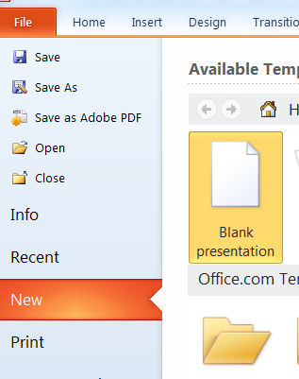
OPTION 1: Save the CAST Template as the Default or “Blank” Template (continued)
OPTION
1
STEP | ACTION
4 | Type “Blank” in the “File name” box (replacing ‘CAST Presentation Template_FINAL_01-02-15.potx’). This step is extremely important. Naming the template “Blank” sets this template as the PowerPoint default Click ‘Save’
5 | Close out of the file Close out of PowerPoint
6 | Open PowerPoint. The CAST template automatically will open as the new default template Alternatively, you can select “File>New>Blank presentation”

Slide 5
OPTION 2: Save the CAST Template as an Additional/Alternate Template
OPTION
2
STEP | ACTION
1 | Open the CAST Template file attached to the email (CAST Presentation Template_FINAL_01-02-15.potx)
2 | Click the ‘File’ tab on the ribbon and select “Save As.” The “Save As” dialogue box appears.
3 | Click the down arrow in the ‘Save as type’ field and select “PowerPoint Template (*.potx)” from the list. The system automatically navigates to the correct template folder on your computer. (e.g., C:\Users\YourName\AppData\Roaming\Microsoft\Templates )

Slide 6
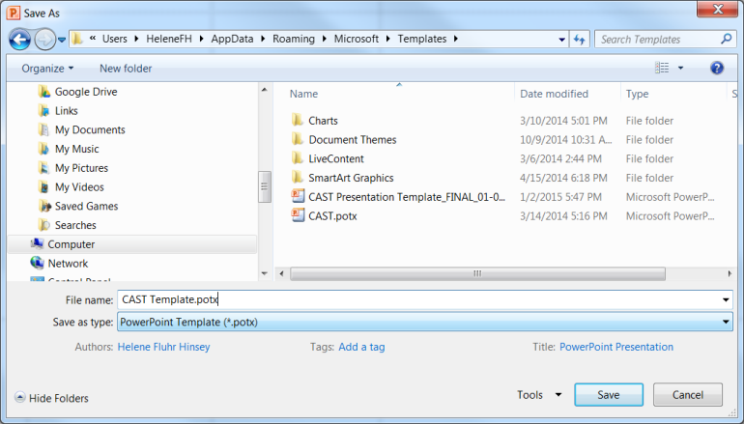

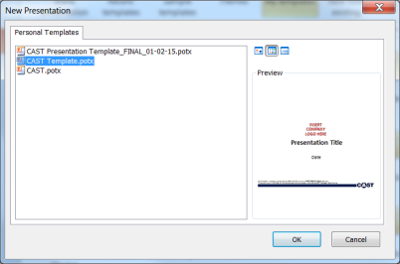
OPTION 2: Save the CAST Template as an Additional/Alternate Template (continued)
OPTION
2
STEP | ACTION
4 | Change the “File name” to “CAST Template” or leave the file name as is Click ‘Save’
5 | Close out of the file Close out of PowerPoint
6 | Access the CAST template: Click on the File tab in the Ribbon. Select ‘New’ Select ‘My Templates.’ The Personal Templates/ New Presentation Dialogue box appears Select the CAST Template from the list. Click ‘OK’

